Slide 1
SAT & ACT Score Year 2017 - 2018 in US
Ivy Chan

Slide 2
Problem Statement
To increase Participation Rate of SAT for States like:
Ohio

Slide 3
Process
Import & Read Data
Data Cleaning
df.info()
numbers of rows
list of columns
null values => update/ drop/remain
data type => convert to appropriate data type
Understand each variable of the data columns
minimum & maximum possible value for each test/subtest
define ways to detect possible errors ie. df.describe(), create functions.etc
fix the error and update with the correct information
Rename column name & Create a Data Dictionary
Drop unnecessary row/ column
Merge cleaned DataFrame and save
EDA
Define Problem Statement based on EDA
Conduct Statistical

Slide 4
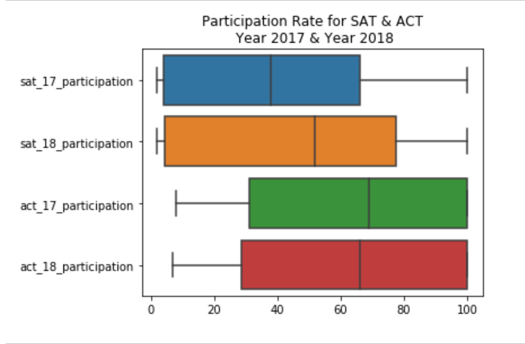
Overview on Participation Rate for SAT & ACT Year 2017 vs Year 2018
There is an increase in Participation Rate for SAT Test from Year 2017 to Year 2018
Year 2017- 4 States 100%
Year 2018- 5 States 100%
There is a slight drop in Participation Rate for ACT Test from Year 2017 to Year 2018
Year 2017- 17 States 100%
Year 2018- 17 States 100%

Slide 5
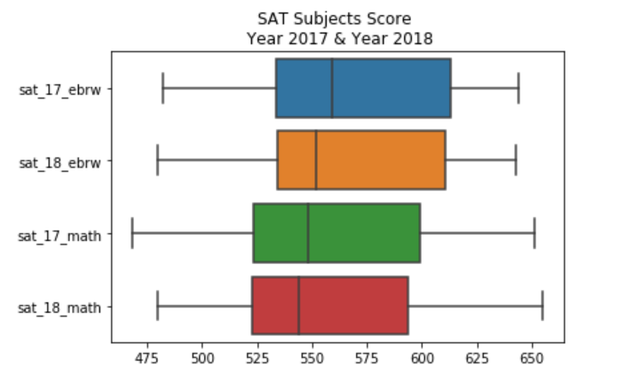
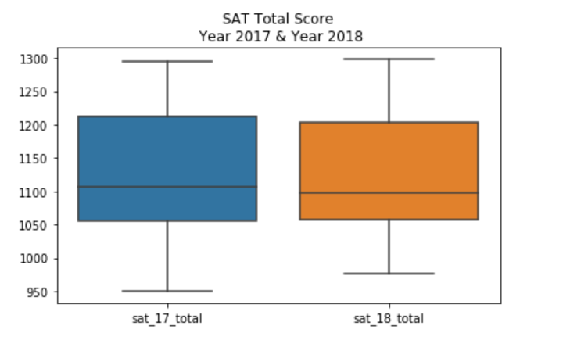
Overview on SAT Subject Score & Total Score Year 2017 vs Year 2018

Slide 6
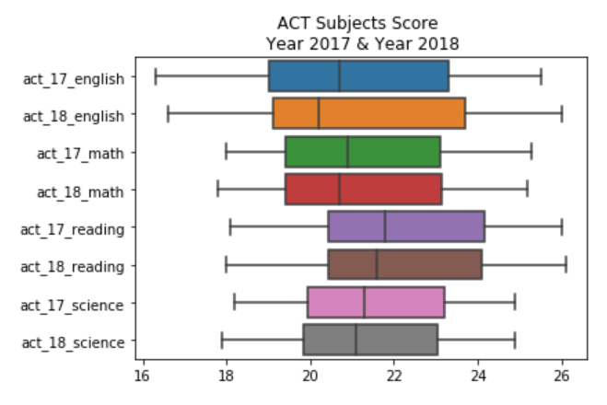
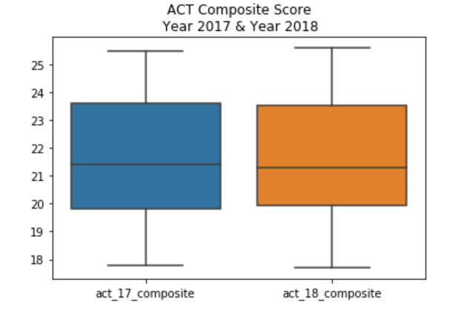
Overview on ACT Subject Score & Composite Score Year 2017 vs Year 2018

Slide 7
Highlights on States' SAT & ACT Participant Rate Year 2017 vs Year 2018
Colorado:
There's a switch trend in test taken for state Colorado observed.(from ACT to SAT)
In Year 2017, the participation rate is higher for ACT test (100%) compared to SAT test (11%)
In Year 2018, the participation rate for ACT test has dropped to 30% while SAT test has drastically increased to 100%.
Illinois:
There's a switch trend in test taken for state Illinois observed.(from ACT to SAT)
In Year 2017, the participation rate is higher for ACT test (93%) compared to SAT test (9%)
In Year 2018, the participation rate for ACT test has dropped to 43% while SAT test has drastically increased to 99%.
Ohio:
There is an increase in ACT test participation rate observed in Ohio from 75% in Year 2017 to 100% in Year 2018
The participation rate for SAT test in Ohio also shows increase from 12% in Year 2017 to 18% in Year 2018.
Nebraska:
There is an increase in ACT test participation rate observed in Nebraska from 84% in Year 2017 to 100% in Year 2018
The participation rate for SAT test in Nebraska however maintained at 3% for both Year 2017 & Year 2018.

Slide 8
Findings (1)
Minnesota's high average SAT score likely means that only the most prepared, ambitious high schoolers take the SAT.
In Colorado, Connecticut, Delaware, Idaho, and Michigan, every student took the SAT. This usually means that these states require all high school students to take the SAT as part of normal high school testing.
In addition, four other states—Illinois, Maine, New Hampshire, and Rhode Island—as well as the District of Columbia offered the SAT statewide during the 2017-18 school year. But because the test wasn't mandatory for all students in these states for the entire school year, participation rates here are below 100%.
* Information above from prepscholar.com.
https://blog.prepscholar.com/average-sat-scores-by-state-most-recent

Slide 9
Findings (2)
So far there's no compulsory in Ohio State to take either SAT or ACT test.
Ohio State University requires that all applicants submit either SAT or ACT scores. During the 2017-18 admissions cycle, 35% of admitted students submitted SAT scores.
2017-18 admissions cycle, Ohio State University had an acceptance rate of 52%. This means that for every 100 students who applied, 52 were admitted, making OSU's admissions process competitive.
* Information above from
https://www.thoughtco.com/ohio-state-university-gpa-sat-act-786573

Slide 10
Recommendations & Conclusion
To encourage students to be more competitive, it's recommended for the state to make SAT as a compulsory test to be taken in state high school.

